Slide 1


Kaliandra and Charcoal Media
Effects on Dendrobium Orchids
Zakiah Basuni
Leni Rosilawati

Slide 2

BACKGROUND
Orchid is one of the ornamental flowers worth economy tall and many popular society . Growth as well as quality The flowers are greatly influenced by the growing medium . Kaliandra can increase aeration and humidity , while charcoal wood guard porosity as well as pressing harmful microorganisms . Selecting the right planting medium​ become key For produce orchid Dendrobium with optimal growth and quality flowers Good .

Slide 3


01
Orchid Planting Media

Slide 4









Kaliandra as a medium
Benefits for Orchids
Combination with Charcoal
Supports healthy roots, maintains ideal humidity, improves the quality of Dendrobium flowers.
Improves aeration, prevents mold, balances humidity for optimal growth.
Characteristics of Kaliandra Media
Environmental Excellence
Contain more nitrogen​ high , optimal water retention, rich in organic nutrients for orchid growth.
Renewable, readily available, environmentally friendly compared to conventional media.

Slide 5

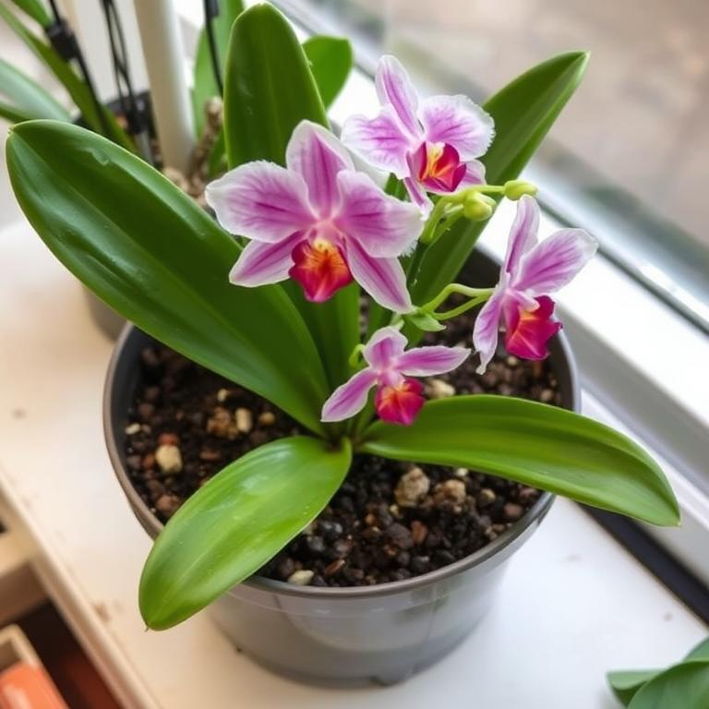
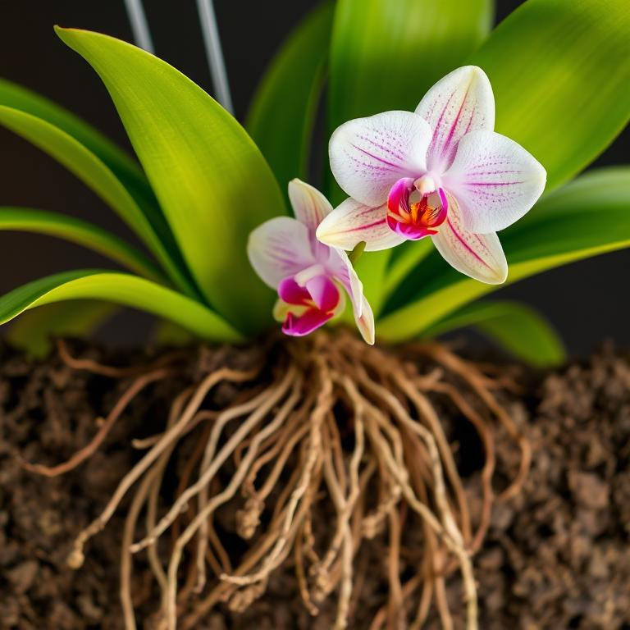
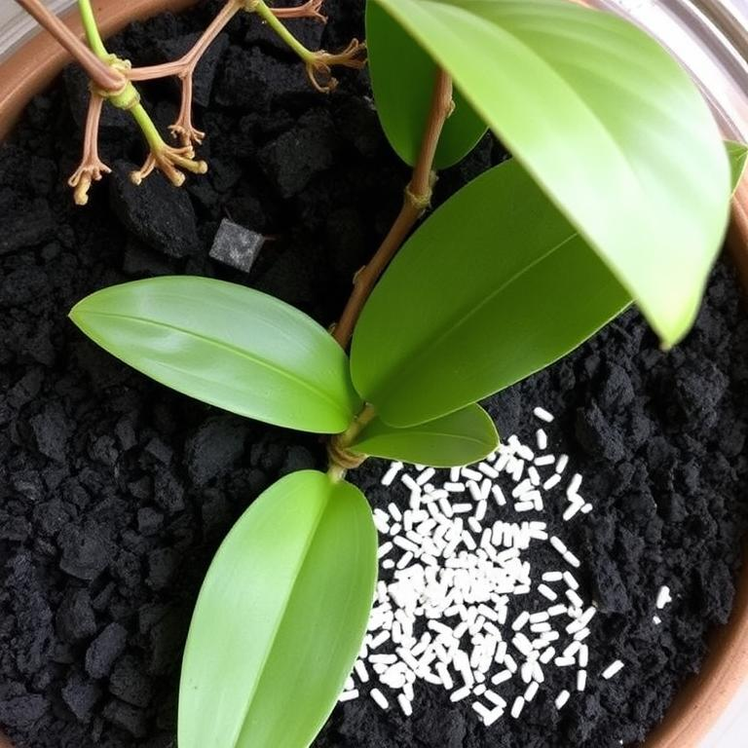
Charcoal as a medium
1
2
3
Characteristics of Charcoal
Media Advantages
Growth Influence
Has high aeration, sterile, prevents fungus, supports orchid root growth.
Not easy to rot, good drainage, maintains optimal humidity for Dendrobium orchids.
Supports healthy root development, improves orchid flower quality.

Slide 6
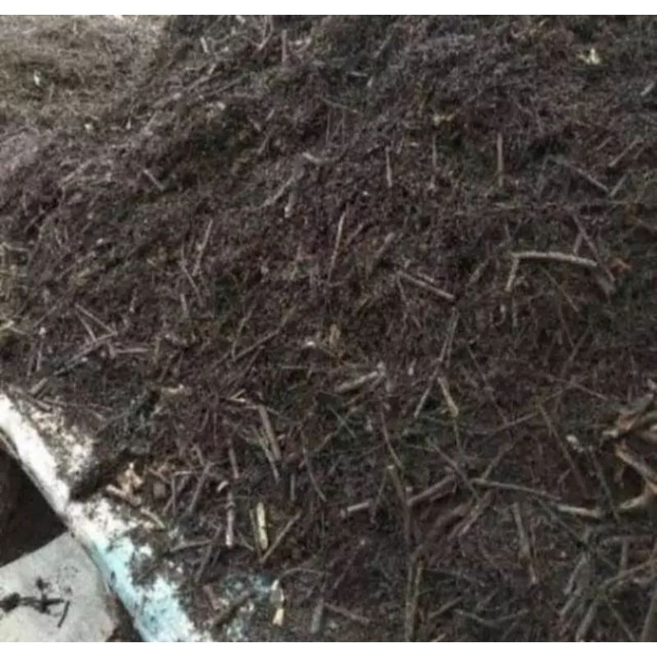
Calliandra as a medium
2
3
Media Advantages
Influence Growth
Growth Influence
Contain substance nitrogen, not easily rotted, good drainage, maintains optimal humidity for Dendrobium orchids.
Supports healthy root development, improves orchid flower quality.
Providing natural nitrogen For growth leaves and stems
More leaves green
Support lush

Slide 7
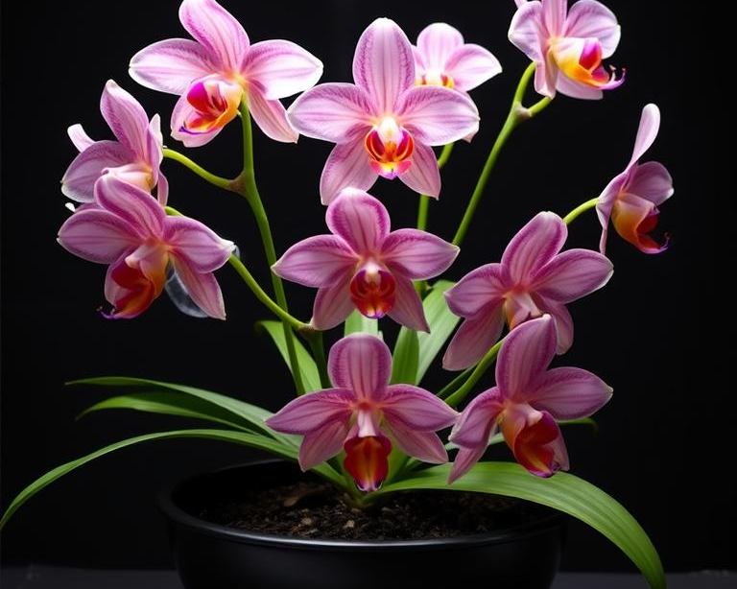
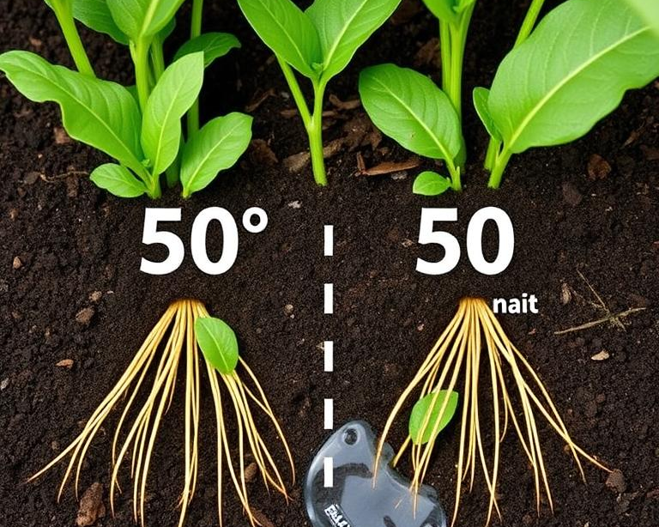
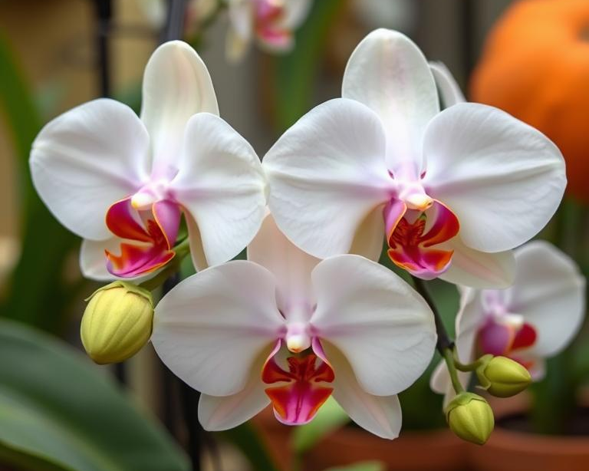
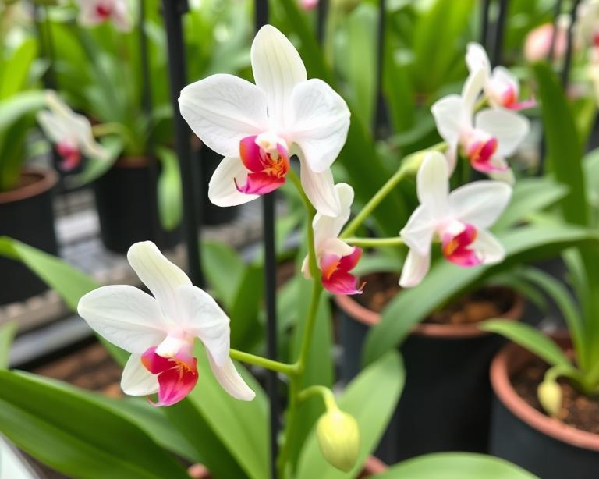
Combination of planting media
Calliandra and charcoal media.
Optimal proportions.
Combination benefits.
Practical applications.
The ideal combination for Dendrobium orchid growth with a balance of nutrients and aeration.
A 50:50 ratio provides sufficient moisture and good drainage for the roots.
Significantly increases vegetative growth and quality of orchid flowers.
Easily available, economical, and environmentally friendly for sustainable orchid cultivation.

Slide 8
02
Vegetative Growth of Dendrobium

Slide 9
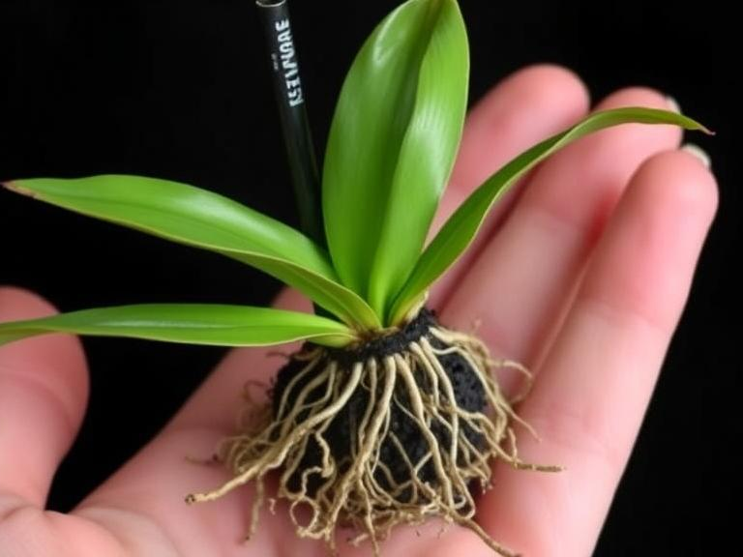
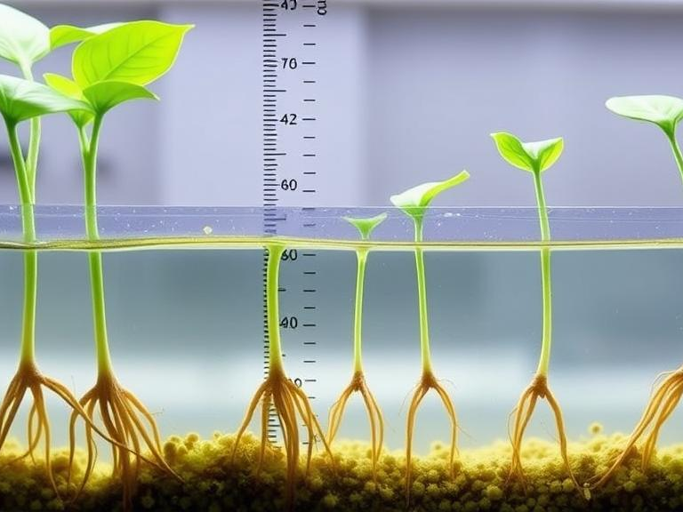
Plant root development
Optimal root growth.
Healthy roots.
Calliandra and charcoal media support the development of Dendrobium orchid roots well.
The plant roots show a fresh green color with no signs of decay.
Root length increases.
Strong root system.
Periodic measurements showed significant increase in root length in the combination media.
The planting medium provides good aeration so that the roots grow strong and spread.

Slide 10




Orchid stem height
03
01
Periodic measurements
Optimal growth
Stem height was measured every two weeks from base to shoot.
Calliandra media supports better growth of orchid stems.
04
02
Nutritional influences
Planting media factors
The organic content of calliandra provides nutrients for stem growth.
Aeration and humidity of the media affect the development of orchid stems.

Slide 11




Number of new leaves
Orchid leaf growth
Calliandra Media
Influenced by the planting medium that supports root development and nutrition.
Rich in organic nutrients, contains nitrogen, stores optimal humidity for new leaf growth.
Charcoal media
Media combination
Good aeration, sterile, supports healthy root growth for leaf production.
Provides a balance of nutrients and aeration for optimal leaf growth.

Slide 12
03
Orchid Flower Quality

Slide 13
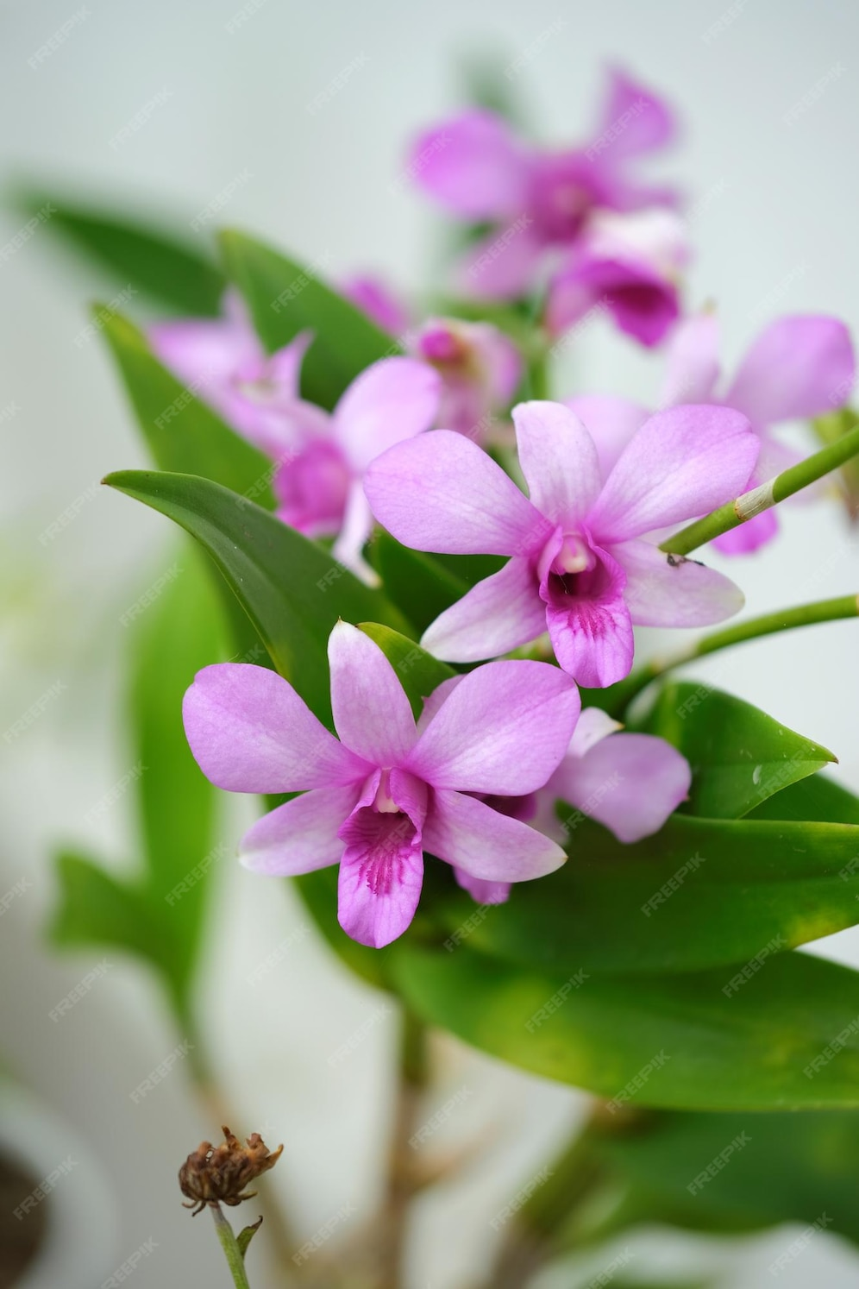
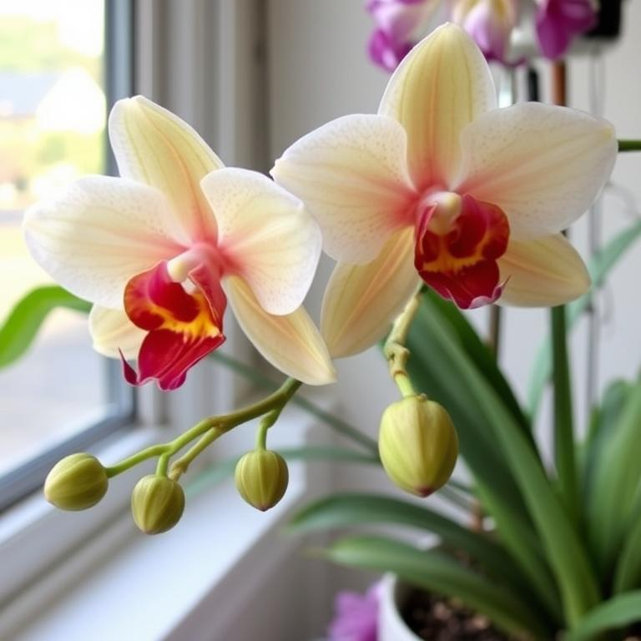
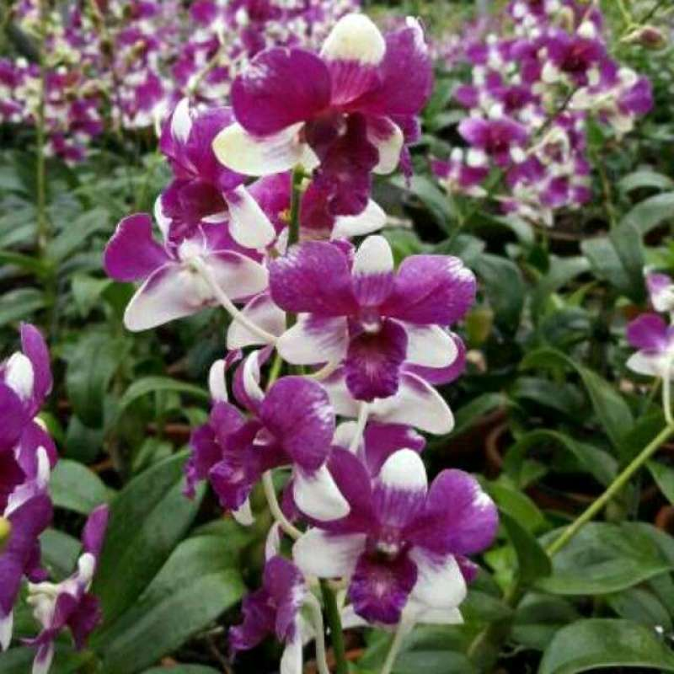
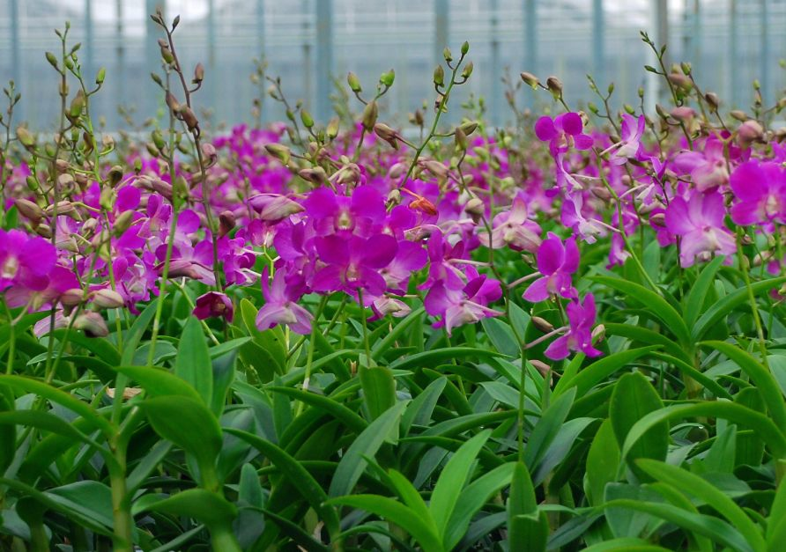
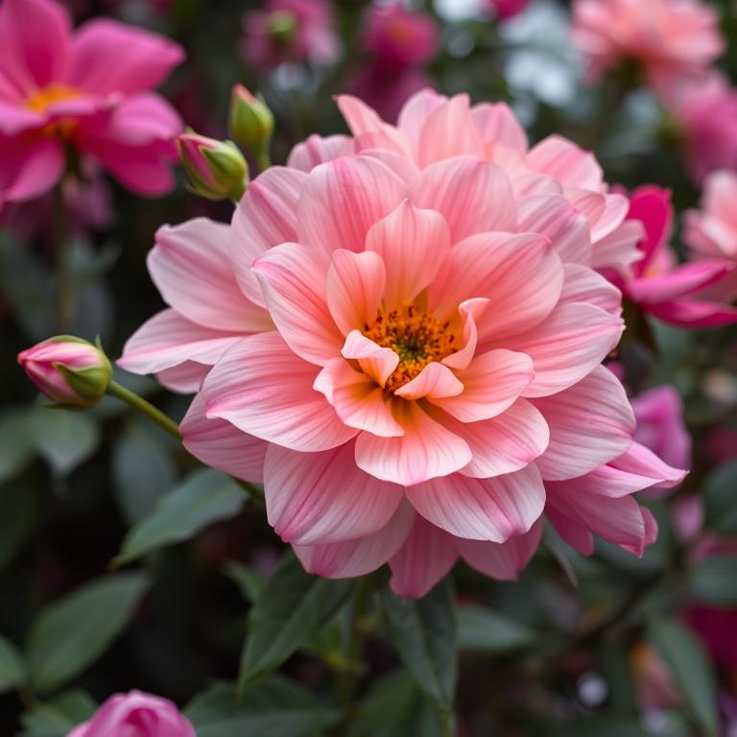

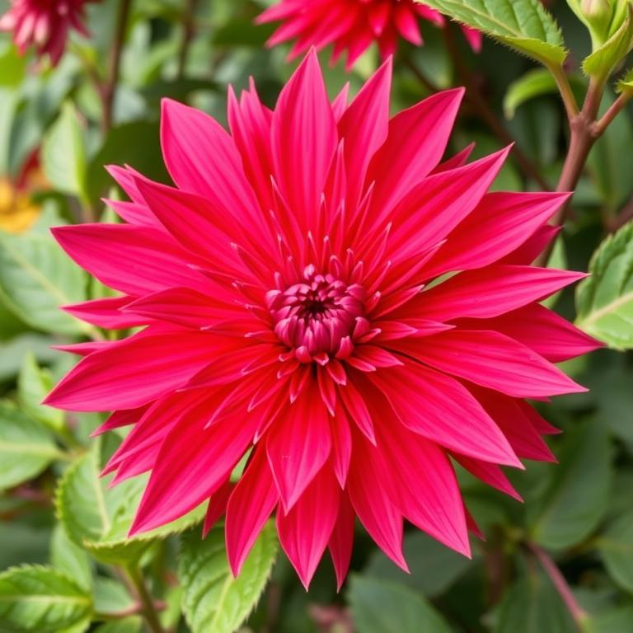
Size and color of flowers
Optimal flower size.
Bright flower colors.
Flower durability.
Amount of interest.
The planting medium affects the size of the Dendrobium orchid flowers.
Calliandra media nutrition produces more intense flower colors.
The combination of media increases the resistance of flowers when they bloom.
Charcoal media supports more flower production.

Slide 14
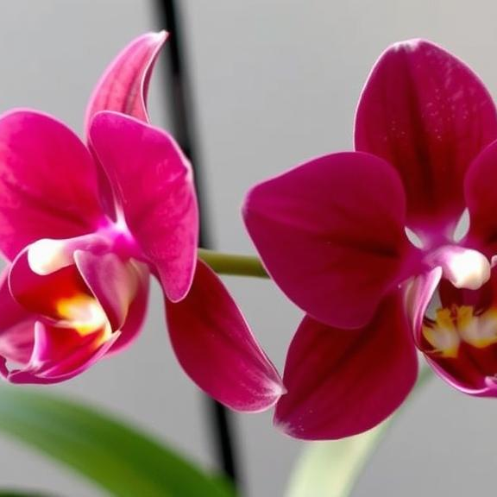
Flower durability
Planting media factors.
Optimal humidity.
Calliandra and charcoal media affect the durability of Dendrobium orchid flowers.
The balance of water and air in the media prevents damage to the flowers.
Balanced nutrition.
Good aeration.
The organic content of the media supports the quality and durability of the flowers.
Air circulation in the media keeps the flowers fresh longer.

Slide 15




Amount of interest generated
Calliandra and charcoal media affect the number of Dendrobium orchid flowers.
Planting media factors
Nutritional balance supports the formation of more flowers.
Optimal nutrition
Ideal temperature and humidity increase flower production.
Environmental conditions
Healthy plants produce more and better quality flowers.
Plant health

Slide 16

Thanks!

